Slide 1
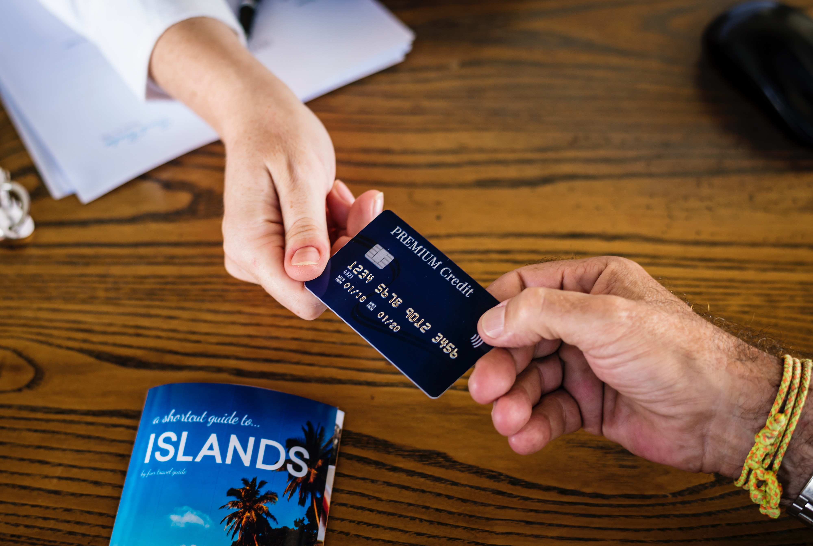
Group 2 Credit Card Prediction
Cody Gardner
Bradley Barker
David Owens
Marie Prosper

Slide 3
Technologies

